Slide 1
Using BCI Data to Predict Emotional Behavior
Andy Do & Hanley XiaoHong Yu
Cogs 189 WI21
Team 7
Notes:
Hello my name is ___ and I’m here with my partner ___. In this project, we are using a BCI dataset to predict emotional behavior.

Slide 2
Introduction
Motivation
Problem
Importance
We want to create a model to predict human emotion using neurological signals, which can be used to better understand emotions and foster greater empathy in people.
Human emotions are complex and have a large spectrum of expression. Emotions have nuance and people show their feelings in different ways.
Having a predictive model allows us to extrapolate basic emotions (positive, negative, neutral), which has a variety of benefits, such as improved communication, emotional or traumatic therapy, education, etc.
Notes:
In this project, we attempt to create a model that will predict the emotions of users at that specific moments in time. Human emotions can be complex, but can generally be categorized into: positive, neutral, or negative. This could be important because using an external device, we can attempt to correctly predict how the user is feeling. An example of real life use could be when a patient does not know how they are feeling to a certain situation, so once we can perfect the model, we can accurately obtain the exact feeling of a patient.

Slide 3
Related Work
Literature
Previous Class Work 2019
Bird, Jordan & Ekart, Aniko & Buckingham, Christopher & Faria, Diego. (2019). Mental Emotional Sentiment Classification with an EEG-based Brain-machine Interface.
Link
Bird, Jordan & Faria, Diego & Manso, Luis & Ekárt, A. & Buckingham, Christopher. (2019). A Deep Evolutionary Approach to Bioinspired Classifier Optimisation for Brain-Machine Interaction.
Link
EEG Brainwave Dataset: Feeling Emotions
Kaggle Dataset
MNIST Brain Digit - (2019 Class Project by Justin Nguyen, Waylon Chang, Leyi Shang, Jeffrey Feng)
Notes:
Here are the related works for this project. The first 2 literatures on the left box are used to interpret how the dataset was obtained. The Kaggle dataset is also included in case anyone wants to attempt to create a better model. We referenced a project done in this class in 2019 which is provided on the right box.

Slide 4
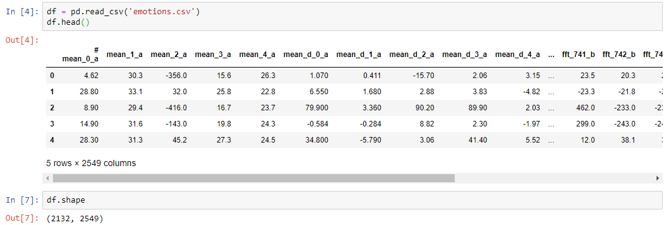
Reading Dataset
Importing dataset csv file on Jupyter Notebook
Notes:
To start this project, we must first read the dataset. As we can see, there are 2549 columns that get measured in this dataset and 2132 samples. We must first filter the dataset to fit our model. However, the model we chose only tests the "mean" columns. It is important to note that the descriptions of the columns are not very clear because there is no metadata for it. We emailed the creators of the dataset but did not receive a response. Further research revealed that others have also posted on forums about this problem, but there appears to be no public reply either. Knowing this, we decided to proceed with the features in the first five columns, inferring that it is the mean signal of that general area.

Slide 5

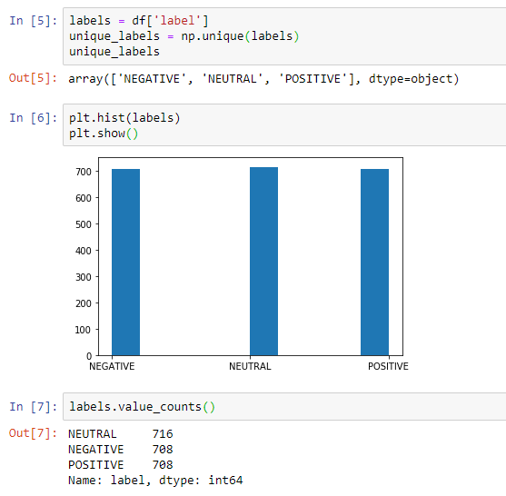
Pre-Processing
Check dataset for nulls to ensure validity and effectiveness of data.
Here, we are visualizing the distribution of the labels to see if there is any skewness
Notes:
We start by making sure the data is in an understandable format. First, we have to check if there are any missing values. We can check if anything is null by running .isnull. We can then take the sum of all true and false, and then checks if there exist any Trues by running .any(). Through this, we prove that there exist no missing values. This is a very good thing for us because this means that we do not have to any amputation for missing datas. We also plotted the distribution for the labels and we can see that they are approximately normal.

Slide 6
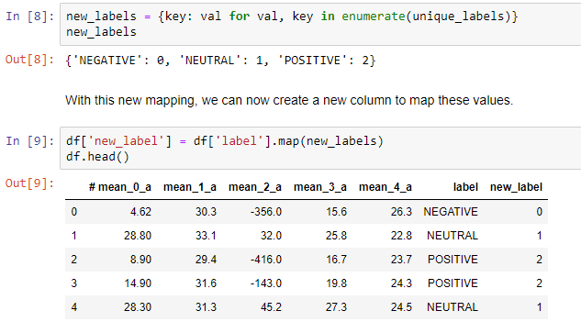
Pre-Processing cont.
Creating a new mapping for the label because the “label” column is currently a string
Notes:
The label right now is currently either positive, neutral, or negative in a string format. We know that the label is a categorical feature, so we can just assign it to a map. In this case, we assigned negative to be 0, neutral to 1, and positive to 2. You can see us here making the new mapping for this and creating a new column for it.

Slide 7
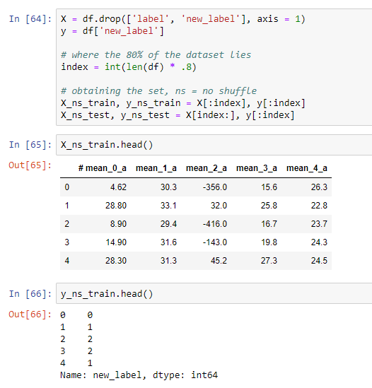
Pre-Processing cont.
Obtaining the training and testing set
Notes:
The training set will be the first 80% of the dataset and the testing set will be the last 20% of the dataset. Because this dataset is sampled by time, the ordering of the data may be dependent on each other. We will be performing a t-test at the end to see if this statement is true. This training subset will be used to train our model, and the testing subset will be used to see how well our model performs.

Slide 8
Training
With 5 features, we will create 5 models through SVM:
𝑀1: [mean_0_a]
M2: [mean_0_a, mean_1_a]
M3: [mean_0_a, mean_1_a, mean_2_a]
M4: [mean_0_a, mean_1_a, mean_2_a, mean_3_a]
M5: [mean_0_a, mean_1_a, mean_2_a , mean_3_a, mean_4_a]
Our process will be the same for each model:
Create our feature vector by creating a column of ones
Convert the features into a list
Appending them to create a training vector
Train the model on it
Get the accuracy of each model on the training set
Notes:
Because we are incorporating 5 different features, we will be cross-validating our models to make sure that we are not overfitting the model. The 5 models that we will be producing is given above. Essentially, we are using a sequence of the mean columns. The pipeline for each model is given in the second box. We will start by creating a column of ones for the constant. We will then convert the feature into a list. Now that we have 2 lists, we can append them to make our feature vector. We will then train our model on the feature vector and get the accuracy to determine which model performs the best.

Slide 9
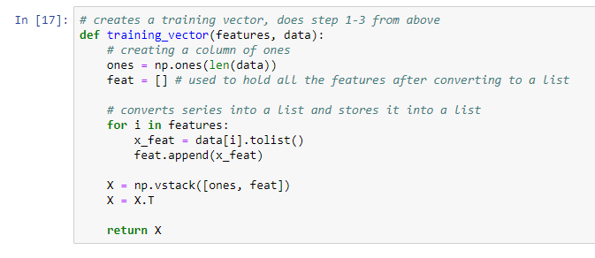
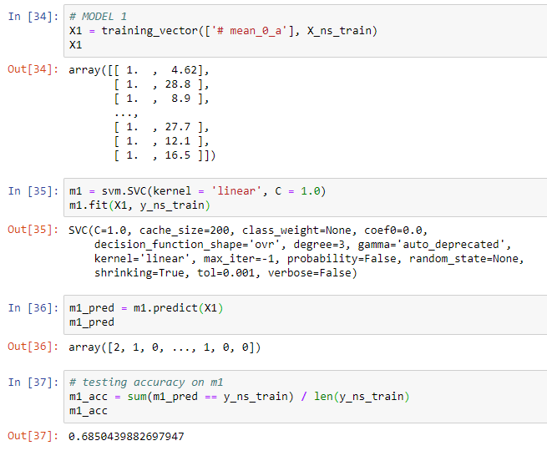
Creating the models [1/3]
Creating model 1
Using this function, we can create our feature vector to be used for training the models
Notes:
Here is an example of us creating the models. We create a function that automatically does step 1 to 3 from the pipeline on the previous slide. The function creates a column of ones, converts the feature columns into a list, and then appends them. On the right, this is the process to creating the model. We create a training vector by using the function, creating a support vector classification model and fitting it with the training vector. Using the model, we then predict the same dataset to obtain the accuracy.

Slide 10
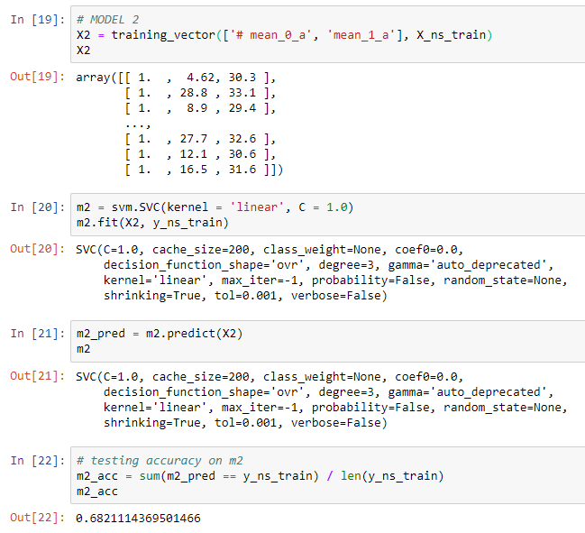
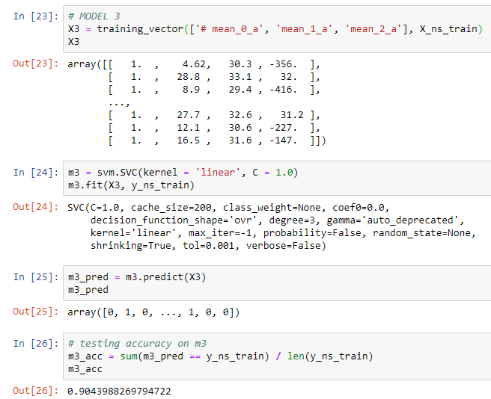
Creating the models [2/3]
Creating model 2
Creating model 3
Notes:
Here is us creating model 2 and 3. The process is still the same, but with the extra features added. We can also see the big jump in accuracy between model 2 and model 3.

Slide 11
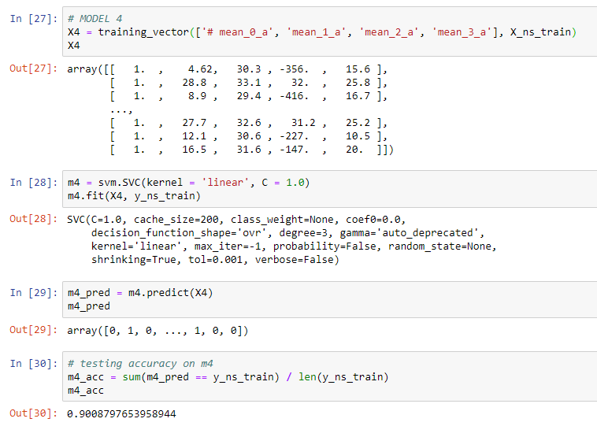
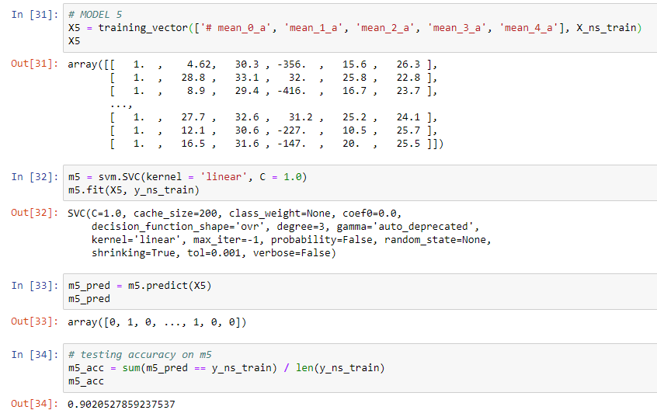
Creating the models [3/3]
Creating model 4
Creating model 5
Notes:
Here is model 4 and model 5. We can see that the model actually ends up doing worse when we fit in more features. This is due to overfitting the model because there are too many features.

Slide 12
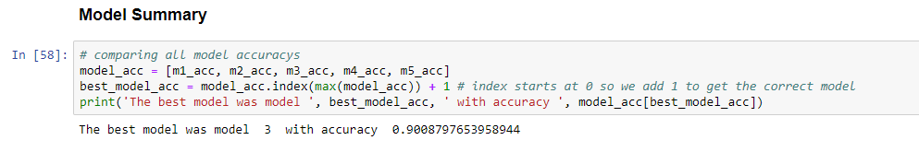
Obtaining Best Model
Model 3 performs the best on the training dataset with no shuffle
This proves that using all the features would have overfit the model
Notes:
Our results show that model 3 performs the best on the training dataset. We had previously assumed that more features would provide a more accurate prediction, but it appears that an increase in features overfits the model. Thus, based on our training model accuracy, we will proceed with project using model #3.
Hanley stop fixing my shit bro it’s perfect

Slide 13
t-test
Let 𝜇₀ = the mean of the accuracy of model 3 on the non-shuffled dataset and 𝜇₁ = the mean of the accuracy of model 3 on the shuffled dataset
We will be testing H₀: 𝜇₀ = 𝜇₁ vs. H₁: 𝜇₀ ≄ 𝜇₁
This dataset was taken in intervals of 3 minutes
This means that the dataset could be influenced by the ordering of the dataset
To test whether there is a time significance in the dataset, we will perform a t-test where ɑ = 0.05
We will generate 1000 simulations of gathering random sample points and testing the best model (model #3) on the random sample to obtain an accuracy
We will gather all 1000 accuracy and perform a t-test with the random sample accuracy vs. the non-random accuracy
Notes:
One very important thing to note about this dataset is that each sample was taken in intervals of 3 minutes. This could hint at some bias because the sample’s emotions could be influenced from the emotions beforehand. In order to test whether this is true, we set up a t-test where we compare alpha = 0.05. To perform a t-test, we will do 1000 simulations where we shuffle the dataset and test it against the accuracy we got from model 3. We state mu 0 to be the mean accuracy of model 3 and mu 1 to be the mean accuracy of model 3 on the simulation dataset. The null hypothesis will be mu 0 is equal to mu 1 and the alternative hypothesis is mu 0 is not equal to mu 1.

Slide 14
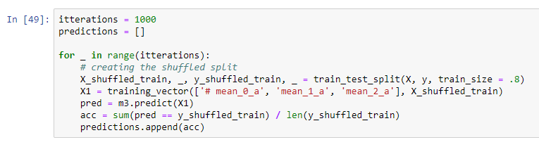
t-test (code)
1000 Simulations
Reproducing the value for the non-shuffled dataset
Notes:
This is how we are generating the simulation. We obtain a random 80% of the dataset and repeat the same process like when we create the model. The difference here is that we are not creating the model, but using model 3 to predict the shuffled dataset. We obtain an accuracy and append it to a list to hold all of the accuracy generated. Since there are 1000 values in the predictions list, we need to replicate 1000 accuracies as well for the original accuracy in model 3.

Slide 15

Interpreting t-test
Obtaining the p-value
Since the p-value we obtain here is 1.18e-21 and is less than ɑ = 0.05,
we reject H₀ in favor of H₁
This means that there is a time significance in the dataset and that the dataset is dependent on the time the sample was collected
Notes:
We obtain a p value of 1.18 to the negative 21. This is lower than the alpha we were comparing it to, so this means that we reject the null hypothesis for the alternative hypothesis. This means that the mean of the non shuffled dataset is different from the mean of the shuffled dataset. Because of this, we can conclude that there is a time significance in the dataset.

Slide 16
Results
Discussion
Unfortunately, we can not proceed to use our model on the testing set because of the t-test
t-test demonstrated that time was a significant factor in this dataset
Because of this, there is no reason to continue on testing with our model if we know that the rest of the dataset is influenced by time
Notes:
We would like to continue with our project and attempt to predict the remaining 20% of the dataset, however, the t-test proves that it would not be effective because of the time dependency. We discovered that given the 5 mean columns, it is more effective to just use the first 3 than to use all of them due to overfitting. Our model, when used upon the same dataset, actually performed very well with an accuracy of 90%. When we first selected this dataset, we hoped that time would not be a significant factor in this dataset so that we can use our model to predict the testing set.

Slide 17
Further Discussion
Problems
We were unable to contact the creator of this dataset for the column descriptions
Because of this, we continued our project with our assumptions of what the columns represent, given the column name which means we can assume incorrectly
Extensions
Knowing the column descriptions: improved feature selection
When selecting features, we could have done combinations of all the 5 features
Problems and Areas for Extension in Future Research.
Notes:
A problem we ran into was not being able to fully interpret the column name. This is very unfortunate for us because we just had to assume what the columns represented, which means that our assumptions of the columns could have been wrong. If we had more time, we could have picked a different dataset that included column descriptions. This would improve our feature selections because we would have a better understanding of the columns.
Also, we would have prefer to select a dataset that is not influenced by time so that we can use our model to predict the labels. Another extension could be that when we were selecting features, we could have done all combinations of the 5 features we selected. We only went down the list because doing all combinations of features would take too much time.

Slide 18
Thanks for listening!
Notes:
That wraps it up for our project! Unfortunately, we can not proceed any further with our project. Thanks for listening!

